Slide 1

Implementing long read sequencing in rare disease diagnostics
Lorraine Hartles-Spencer
Senior Principal Clinical Scientist
Birmingham Women’s and Children’s NHS Foundation Trust

Slide 2
Introduction to rare disorders and long read sequencing
Project 1: NEEDED
Project 2: Hypotonic infant
Future projects

Slide 3
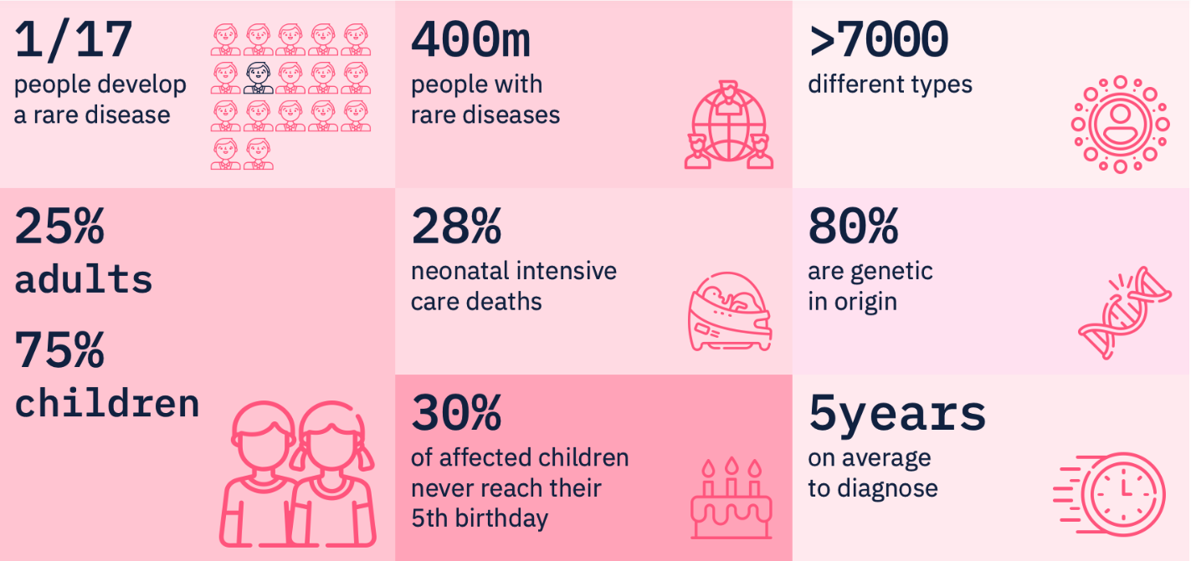
Rare Disorders
Congenica.com

Slide 4
Current NHS testing strategy in rare disease
Single gene testing
Panel testing using exomes
Methylation analysis
Short read Whole Genome Sequencing (WGS)
  Preferably trio approach

Slide 5
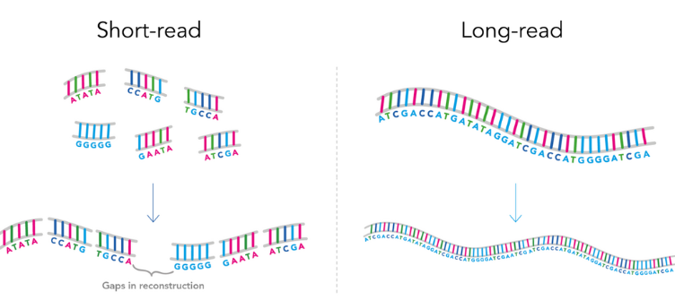
Why long read sequencing
Long read sequencing reduces the need for reconstruction
  Reduces errors
  Reduces ‘dark’ areas of the genome

Slide 6
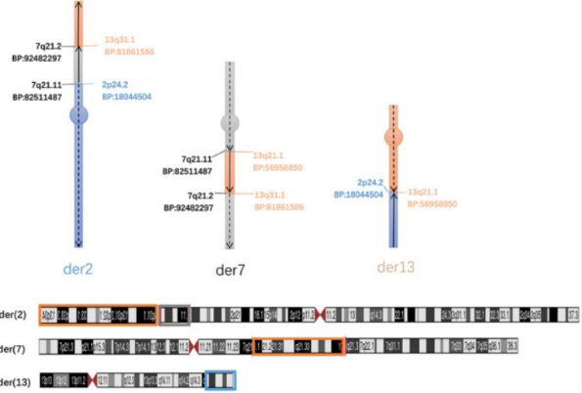
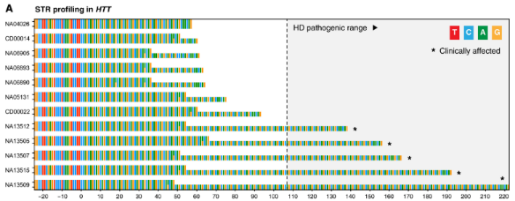
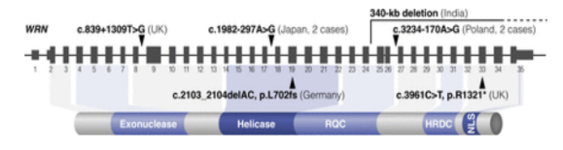
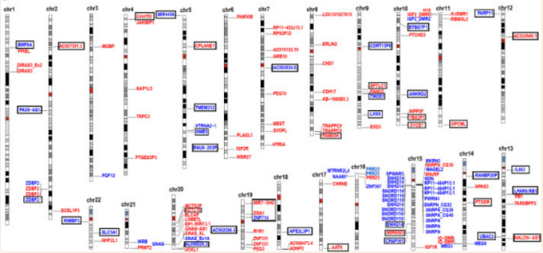
Potential utility of long read sequencing
More Complete coverage
  Pseudogene, GC rich, ‘dark’ regions
Decipher complex chromosomal rearrangements
Detect and size expansion repeat disorders
Epigenomic markers including methylation status
Potential for rapid turnaround (real time)
Provide phasing information from singleton testing

Slide 7
Project 1: NEEDED
Proof-of-Concepts study
To evaluate the future diagnostic potential of Nanopore Whole Genome Sequencing (WGS) in:
  individuals highly likely to have a rare monogenic disorders
  With no known molecular aetiology
  who have already undergone short-read WGS or other standard of care testing

Slide 8


Analysis
Sequencing data processed
Initially UoB in house pipeline
Provides SNV, CNV, SV, STR and methylation data
VCFs uploaded to Geneyx and/or SeqOne
Family analysis through Geneyx and SeqOne platform
Includes trio (parents and proband) or family (sibling) analysis
Variant filtering
AI filtering
Quality filtering
Variant interpretation
According to current ACGS guidelines
Variant confirmation
Confirmation using orthogonal methodology
Includes design of new assay as required
Follow up with custom pipeline from Nour Mahfel (WM BI STP)
Analysis protocol

Slide 9
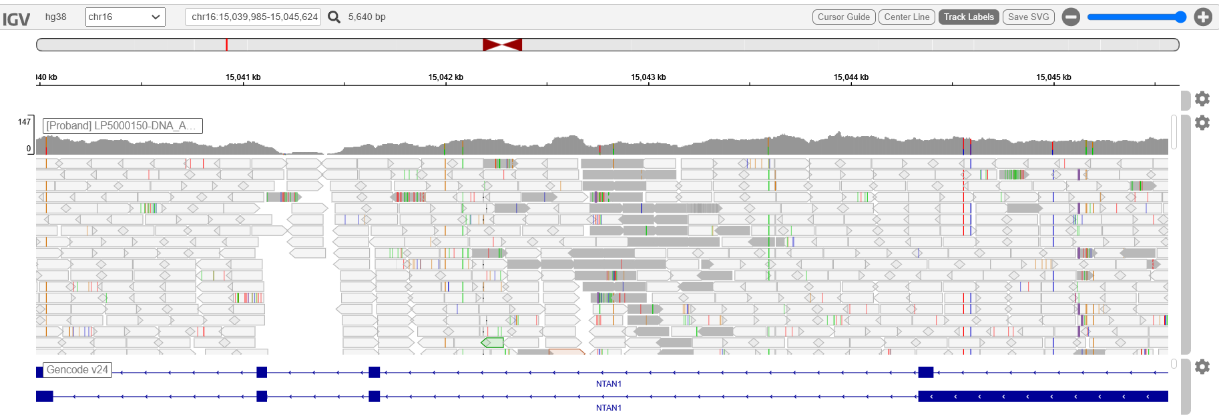
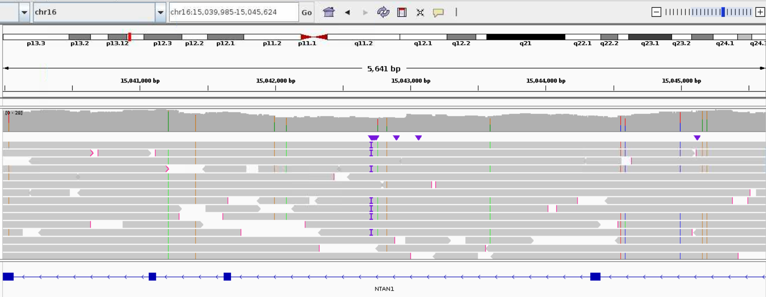
Improved mappability
Comparison with SR WGS data has shown improved mappability reducing the number of false CNV calls

Slide 10
27 families recruited
Category | Number | Examples
Rare disorder or group of disorders suspected | 6 | GINS1- related Immunodeficiency Marfan syndrome Hereditary Haemorrhagic Telangiectasia Familial Adenomatous Polyposis Microcephalic Osteodysplastic Primordial Dwarfism Retinitis Pigmentosa
Suspected autosomal recessive disorder with 1 hit | 1 | Sensenbrenner syndrome
Unknown syndrome | 20 | Aortopathy syndrome Angelman like disorder Developmental and Epileptic Encephalopathy Developmental disorder Skeletal dysplasia

Slide 11
First result
1st child unrelated parents
At birth noted to be dysmorphic, short neck and floppy
Seizures from few hours of age stopped at age 3 weeks then restarted again in childhood
Hypotonia
Developmental delay
Autistic Spectrum Disorder
Large jaw, tongue and coarse features
Mitral valve prolapse
Horseshoe kidney removed (non- functioning)
Hypertrichosis to body
Small head size
Lung surgery for empyema
Myopia
Scoliosis in adulthood
Myoclonic jerks in adulthood
Testing:
Chromosome analysis
Microarray
100KGP
NEEDED

Slide 12
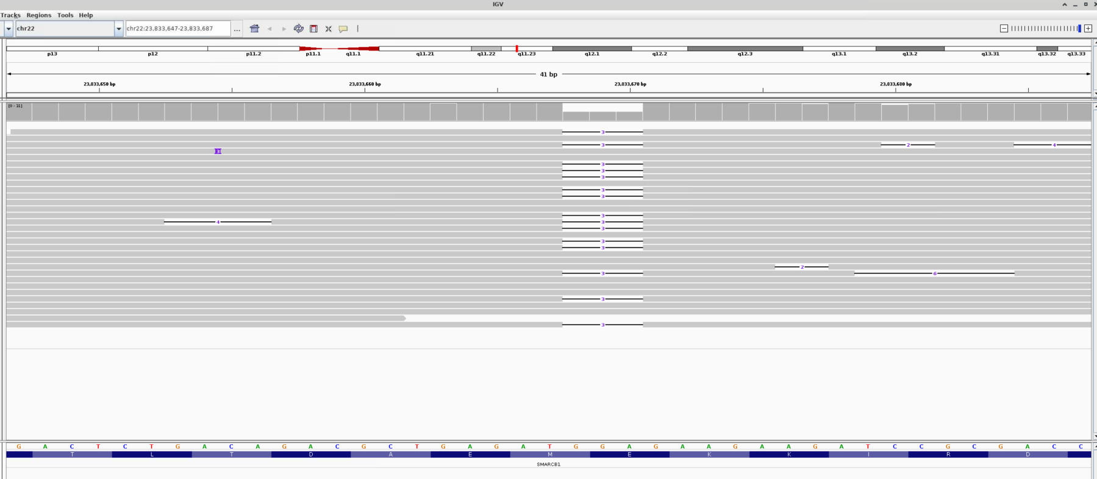
de novo inframe del p.Glu371del in SMARCB1
ENST00000344921.10:c.1111_1113del

Slide 13
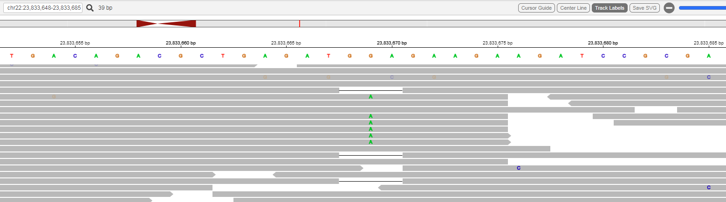
100,000 genomes project
In short read WGS, this was called as two mosaic variants at the same location due to shorter read fragments

Slide 14
Outcome for family
Diagnostic odyssey of about 40 years
De novo
  Reassuring to sister of reproductive age
  NOT X-linked recessive

Slide 15
Second Result

Slide 16
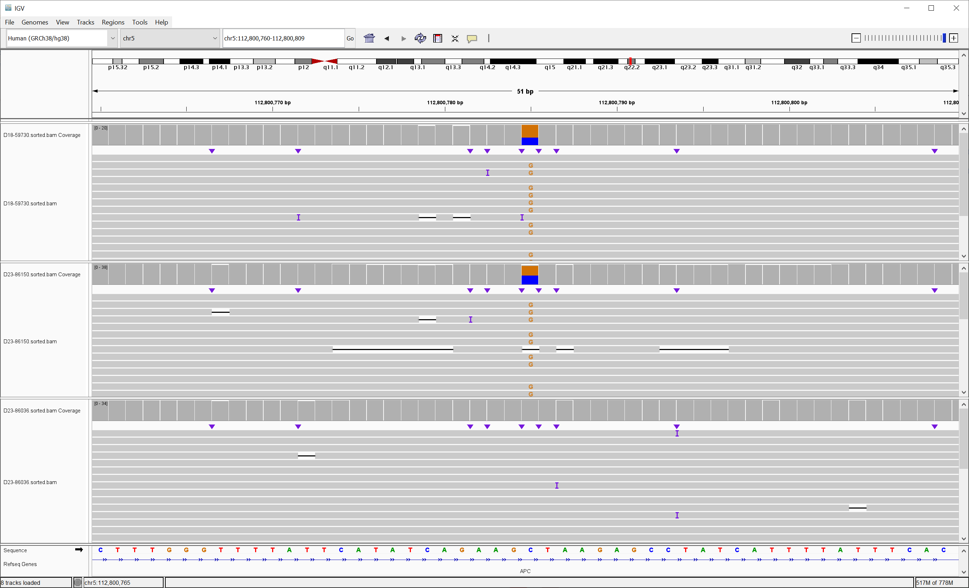
Familial Adenomatous Polyposis
Affected proband:
APC (c.730-494C>G)
Ambry performed RNA studies:
3 cases, all demonstrating substantial presence of a cryptic exon, r.729_730ins730-541_730-495 (predicted p.R244Mfs*65) not present in any wild-type controls.
Affected sibling:
APC (c.730-494C>G)
Unaffected mother

Slide 17
Outcome for family
End diagnostic odyssey
Offer predictive testing
  Prevent unaffected relatives having bowel screening
  Offer prenatal testing options

Slide 18
Further results
Phenotype | Gene | Diagnosis | Further testing
Syndromic immunodeficiency | RNU4ATAC n.13C>T n.48G>A | Roifman Syndrome
Developmental disorder | CRELD1 c.461-340A>G c.575G>A | Jeffries-Lakhani Neurodevelopmental syndrome | RNA studies confirm splicing abnormality
Developmental and epilepsy disorder | ASAH1 c.239T>C | Farber lipogranulomatosis | Enzyme testing

Slide 19
Summary
Proof-Of-Concepts Study
27 trio WGS using ONT long-read
  27 families recruited
  5 results so far…
Demonstrated future potential utility of long read sequencing for diagnosis of rare genetic disorders

Slide 20
Project 2: Hypotonic screen
Proof-of-Concepts and feasibility study
To evaluate the potential of Nanopore adaptive sampling in the hypotonic infant cohort
  SMA
  Myotonic dystrophy
  Prader Willi syndrome
  R69 gene panel

Slide 21
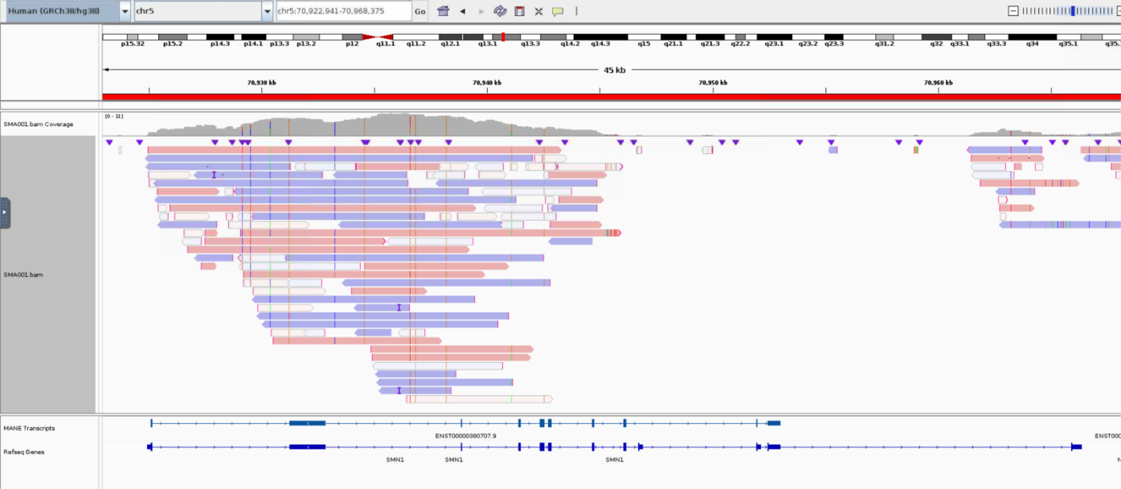
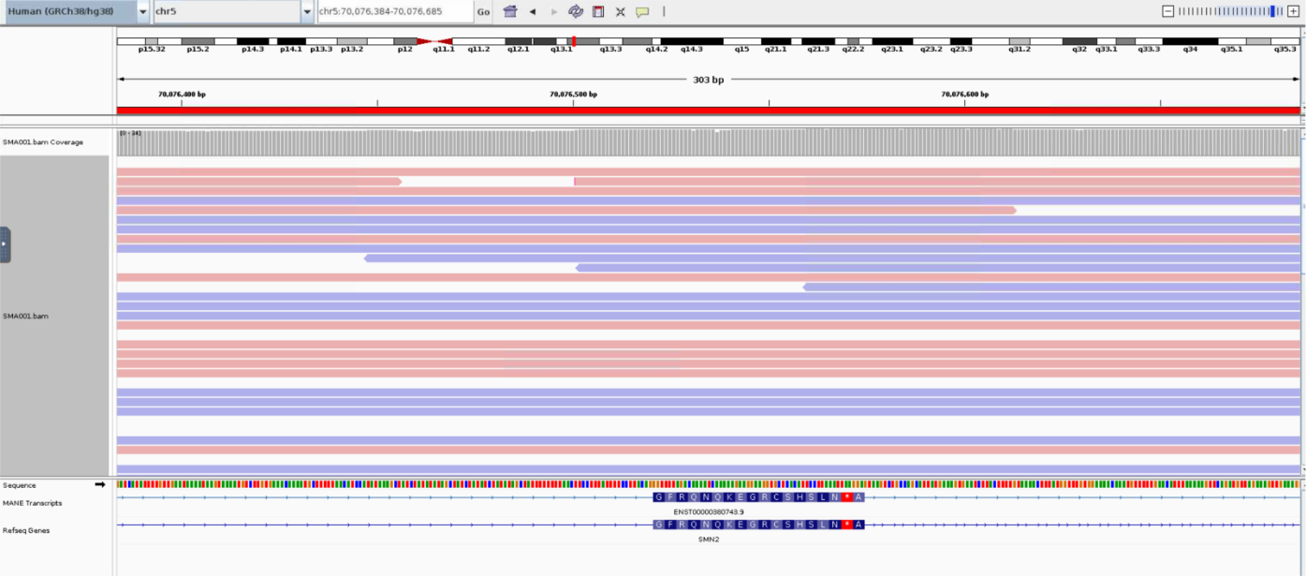
SMA

Slide 22
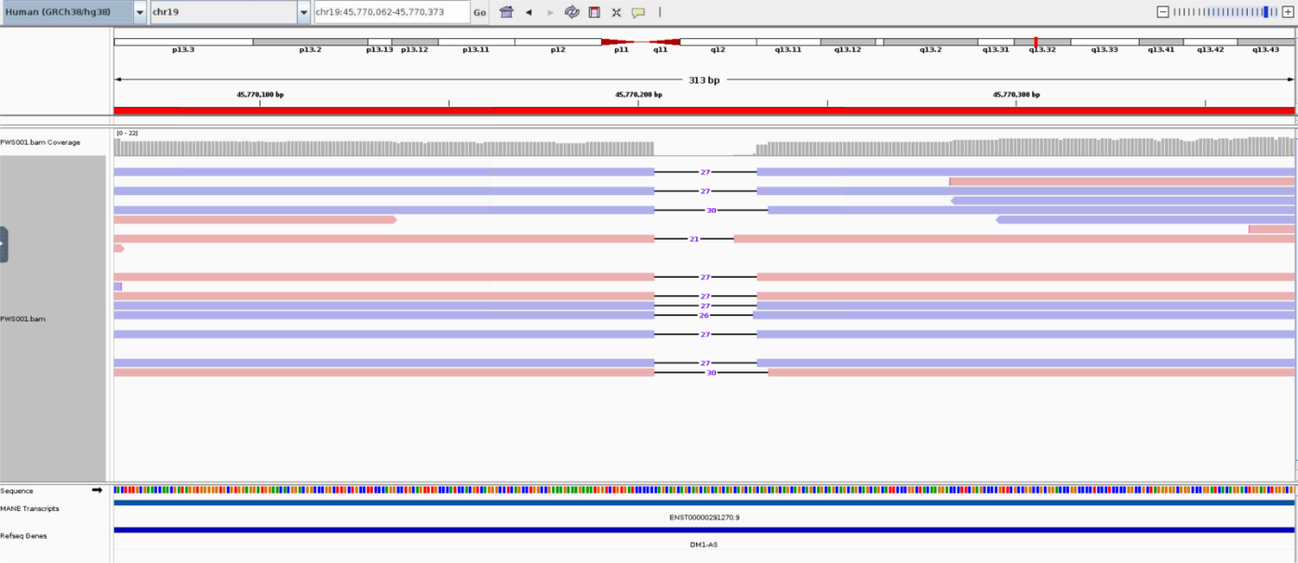
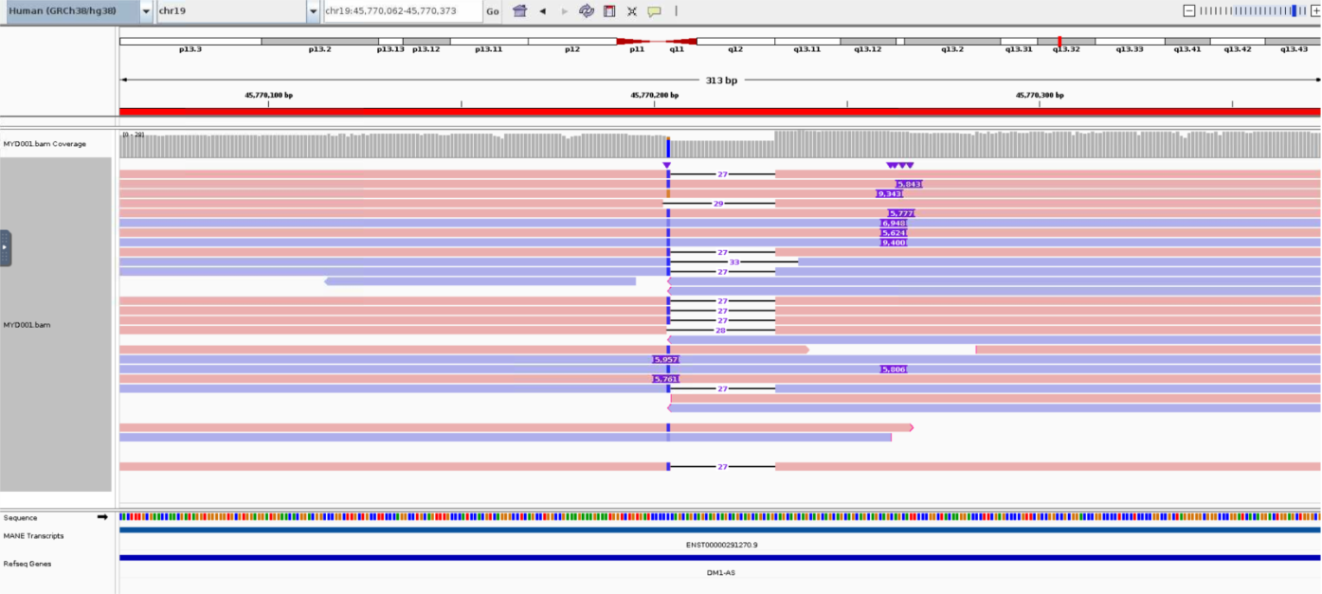
MYD
-ve control
+ve control

Slide 23
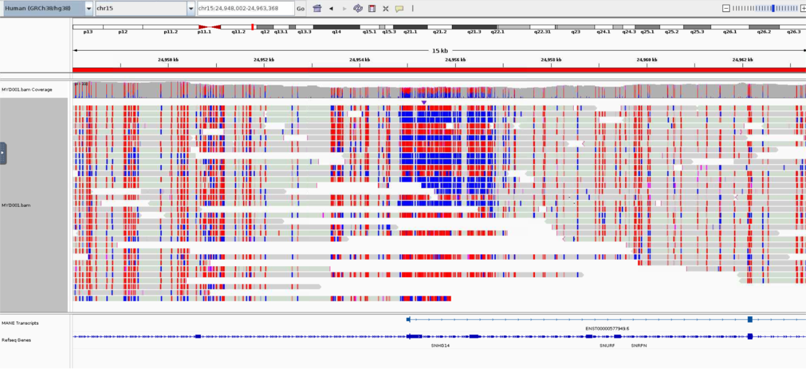
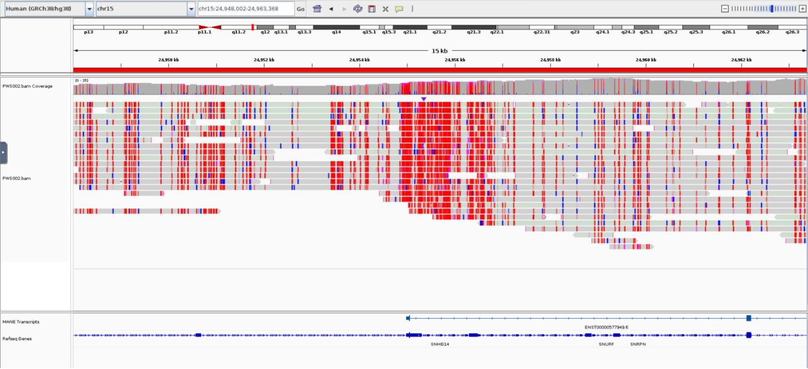
PWS
-ve control
+ve control

Slide 24
Next steps
Improving BI pipeline and analysis pathway
Health economics assessment for viability
Potential for adding additional targets e.g. UPD14q32
Assessing benefit and use of adaptive sampling in other areas of rare disease diagnostics

Slide 25
Further projects
Prenatal diagnostics
Bioresource long read data analysis
Diagnosis in neurological disorders for repeat expansion disorders
Use in reflex testing for phasing, methylation analysis and elucidating structural variants
Implementing in routine clinical practice

Slide 26




Acknowledgements
Big thank you to the families involved
Hannah Titheradge
Andrew Beggs
Danielle Morris
Nour Mahfel
Leyla Ahmed-Ali
Nicola Jones
Jessica Woodley
Joanne Stockton
Luke Ames
Emma Douglas
Madhura Chandrashekara
Jon Hoffman
Jamie Ellingford
Genetic Alliance
Clinical Genetics Unit, BWH

